Slide 1
The Effect of National Measures of Wellbeing on Covid 19 Vaccination Progress
A Data Analysis Project by: Andrew Bly, Jake Burns & Zachary Owen

Slide 2
We expect to find a significant correlation between the rate of successful vaccinations and measures of National Well-being
What is the relationship between fully vaccinated people and economic wellbeing?
What is the relationship between fully vaccinated people and population?
What is the relationship between fully vaccinated people and the nature of health expenditure within that country?

Slide 3
What data did we need?
Kaggle CSV cribbed from the Our World in Data Github Repository
Measures of Wellbeing
Economic
Populace
Educational
Health
World Bank API

Slide 4
Members of each population fully vaccinated per 100
Cleaning the CSV

Slide 5
Data from the World Bank API
Economic Factors
GDP
Poverty Rate
Populace Factors
Total Population
Population Density
Educational
Primary School Completion Rate
Literacy
Health
Percentage of Health Expenditure in the Private Sector

Slide 6
Insights and Problems
Before Cleaning Gibraltar was most vaccinated
Unable to use several measures that we had hoped due to lack of data
Ended up using 2018 data so as to get the widest array of data points

Slide 7
Steps taken during data analysis

Slide 8
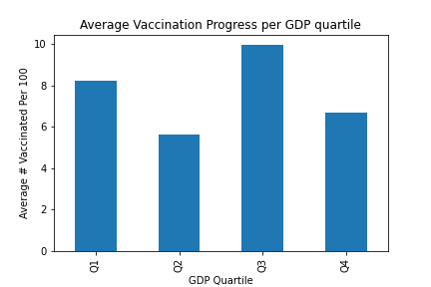
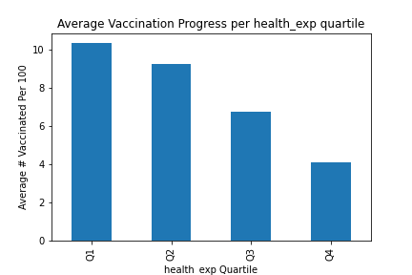
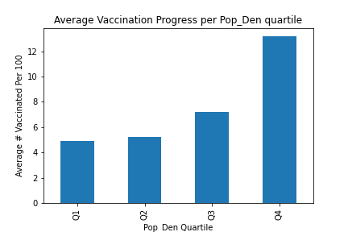
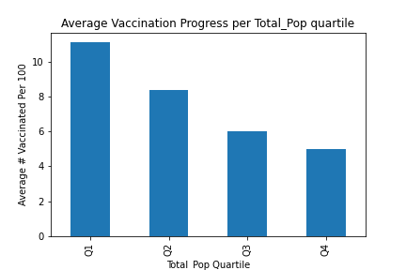

Slide 9
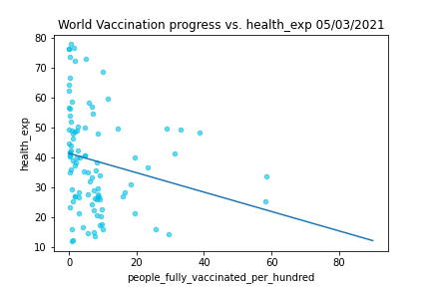
Private Healthcare Expenditure
Per quartile
Linear Regression across all countries

Slide 10
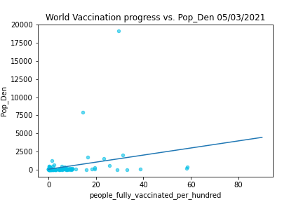
Population Density
Per quartile
Linear Regression across all countries

Slide 11
Discuss Findings
GDP not as impactful as initially expected
Population Density had highest correlation
Private Healthcare Expenditure

Slide 12
Post-Mortem
Time difficulty with the reporting of data
With more time use the newly incoming census data to look at poverty rate as a factor

Slide 13
Questions?

